Slide 1

Lab4: if-else, switch statements; enum datatype
UNT CSCE1030
TA Polina Nemkova

Slide 2
Options
The lab is due on Friday by 11.59pm
WORK BY YOURSELF: This lab instructions are available on Canvas. If you feel comfortable with this assignment, you can do it by yourself. Ask me to check it in the very end before you submit it.
WORK WITH ME: Follow the steps I describe on the slide.

Slide 3
What Do We Need to Submit?
Four files for two tasks:
Lab4A.cpp
Lab4B.cpp
Lab4C.cpp

Slide 4
Step1: Prepare the working space
Pull up the .pdf file for Lab4 from your canvas account;
Start Putty (cse01.cse.unt.edu cse02.cse.unt.edu cse03.cse.unt.edu cse04.cse.unt.edu cse05.cse.unt.edu cse06.cse.unt.edu)

Slide 5
Printf and Scanf
Why do we use it and not cin/cout?

Slide 6
printf()
printf does the same as cout, but faster. How to use printf()?
Example 1 (with string):
printf (“text”);
Example 2 (with variables):
printf("The final values are a:%d b:%d c:%lf d:%e\n",a,b,c,d );

Slide 7
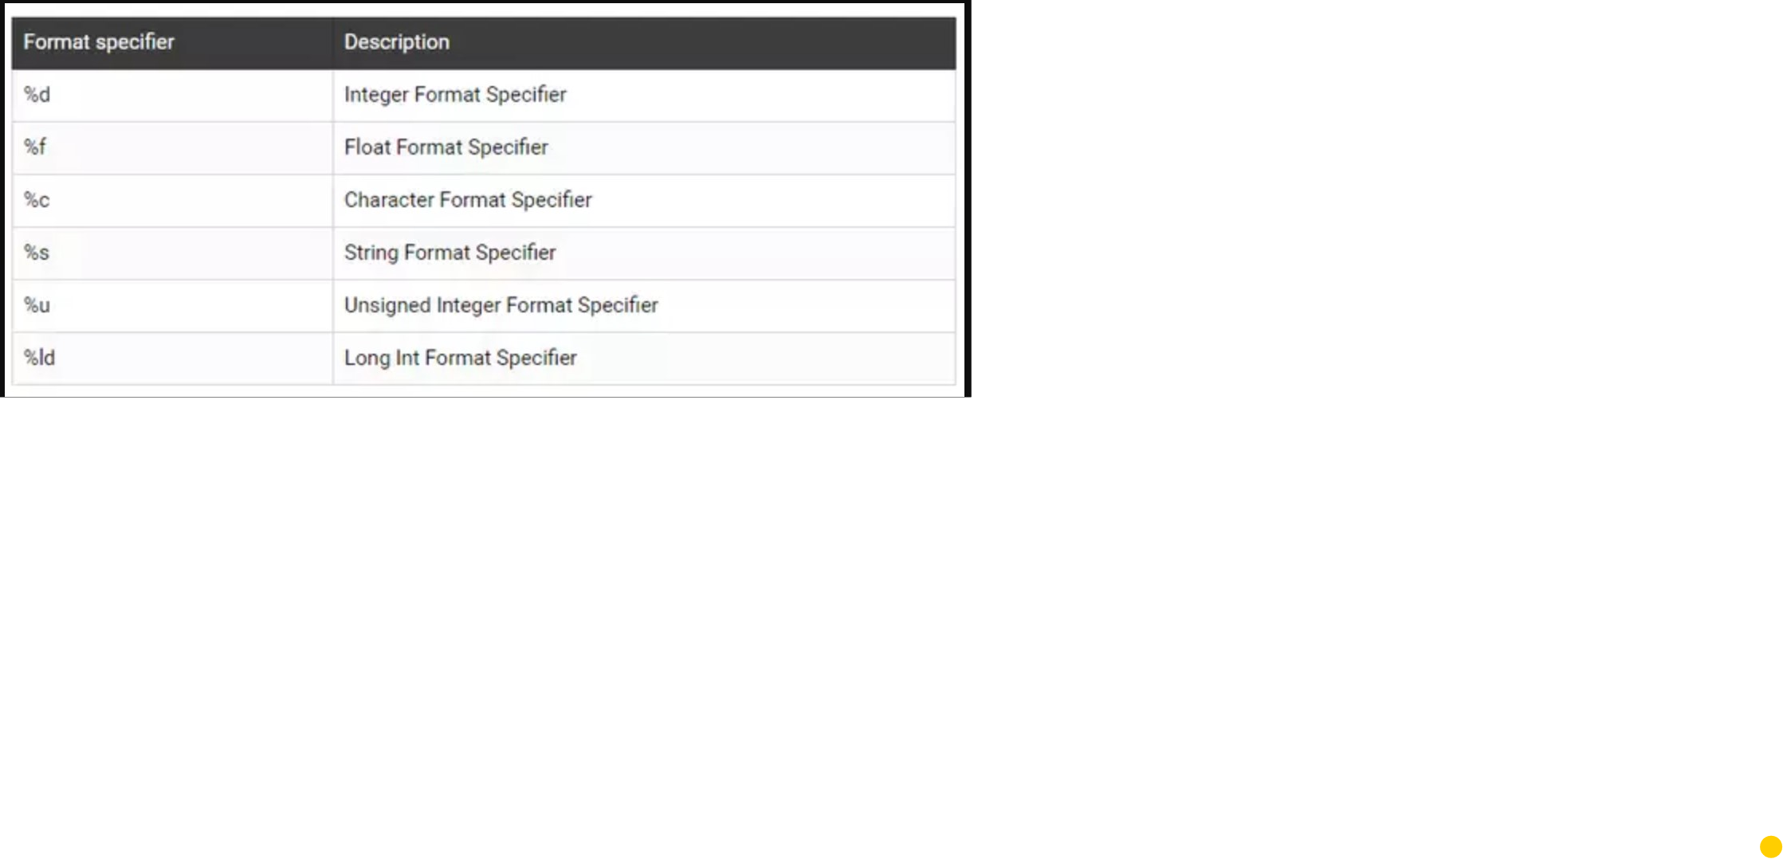
scanf()
scanf does the same as cin, but faster. How to use scanf()?
Example 1:
scanf("%d%d",&a,&b);

Slide 8
General if-else structure
#include<iostream>
using namespace std
int main ()
{
###declare values
if (number < 5) ##condition
{
}
else ##alternative
{
}
return 0;
}

Slide 9
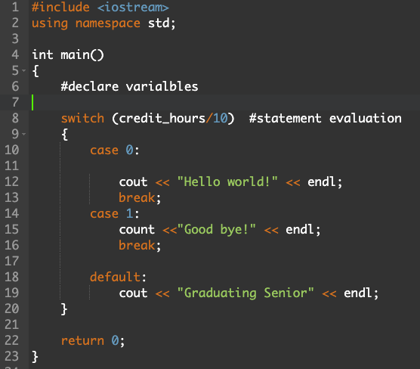
Switch structure
include <iostream>
using namespace std;
int main()
{
switch (credit_hours/10) #statement evaluation
{
case 0:
#output
break;
case 1:
#output
break;
default:
#output
}
return 0;
}

Slide 10
enum datatype
enum Color {RED = 0, ORANGE, YELLOW, GREEN, BLUE, PURPLE};
Color my_color = static_cast<Color>(rand() % 6);

Slide 11
Submission
Go to WinSCP and copy your files from the CSE machine on your computer.
If you want, show me execution of your programs (to be sure that there is no problems).
Submit Lab4A.cpp, Lab4B.cpp, Lab4C.cpp on Canvas.

